Slide 1

EXPENDITURE MULTIPLER Macroeconomics

Slide 2
Change in Autonomous Investment and Equilibrium Income
Following the simple Keynesian model, we take the following assumptions:
The volume of investment expenditure is autonomous.
Consumption is a function of Income and consumption function is linear.
MPC is positive but less than unity.
The economy is a closed one.

Slide 3
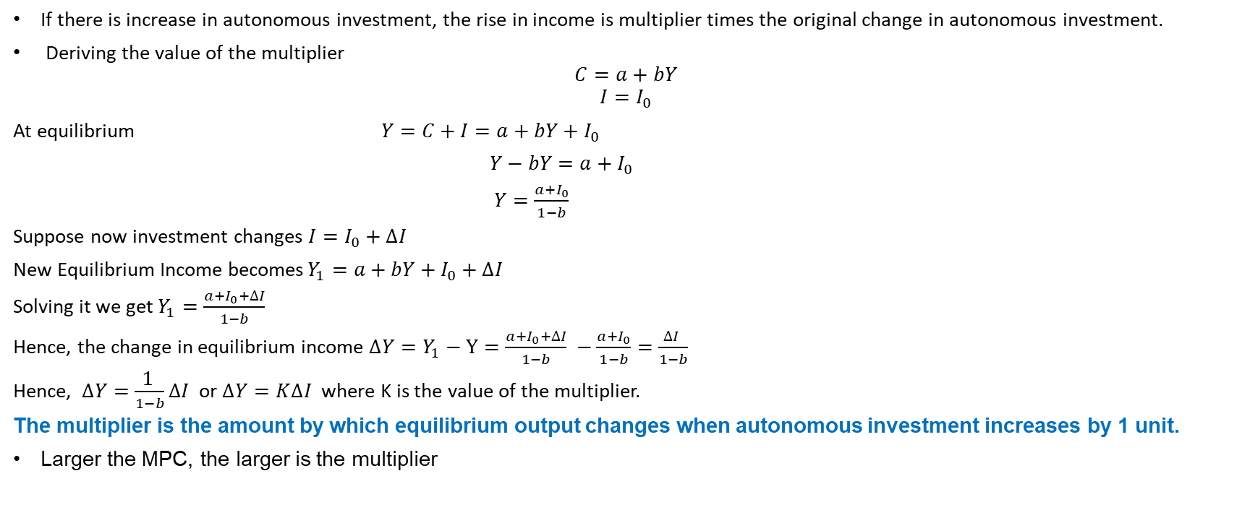
What is Investment Multiplier?
If there is increase in autonomous investment, the rise in income is multiplier times the original change in autonomous investment.
Deriving the value of the multiplier
$$C=a+bY$$
$$I=I_{0}$$
At equilibrium $Y=C+I=a+bY+I_{0}$
$Y−bY=a+I_{0}$
$Y=\frac{a+I_{0}}{1−b}$
Suppose now investment changes $I=I_{0}+∆I$
New Equilibrium Income becomes$Y_{1}=a+bY+I_{0}+∆I$
Solving it we get $Y_{1}=\frac{a+I_{0}+∆I}{1−b}$
Hence, the change in equilibrium income $∆Y=Y_{1}−Y=\frac{a+I_{0}+∆I}{1−b} −\frac{a+I_{0}}{1−b}=\frac{∆I }{1−b}$
Hence, $∆Y=\frac{\text{1} }{1−b}∆I$ or $∆Y=K∆I$ where K is the value of the multiplier.
The multiplier is the amount by which equilibrium output changes when autonomous investment increases by 1 unit.
Larger the MPC, the larger is the multiplier

Slide 4
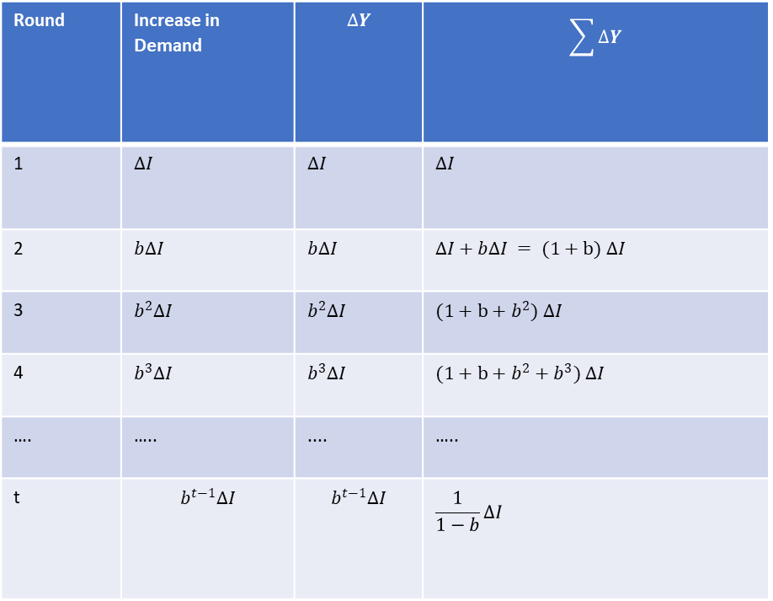
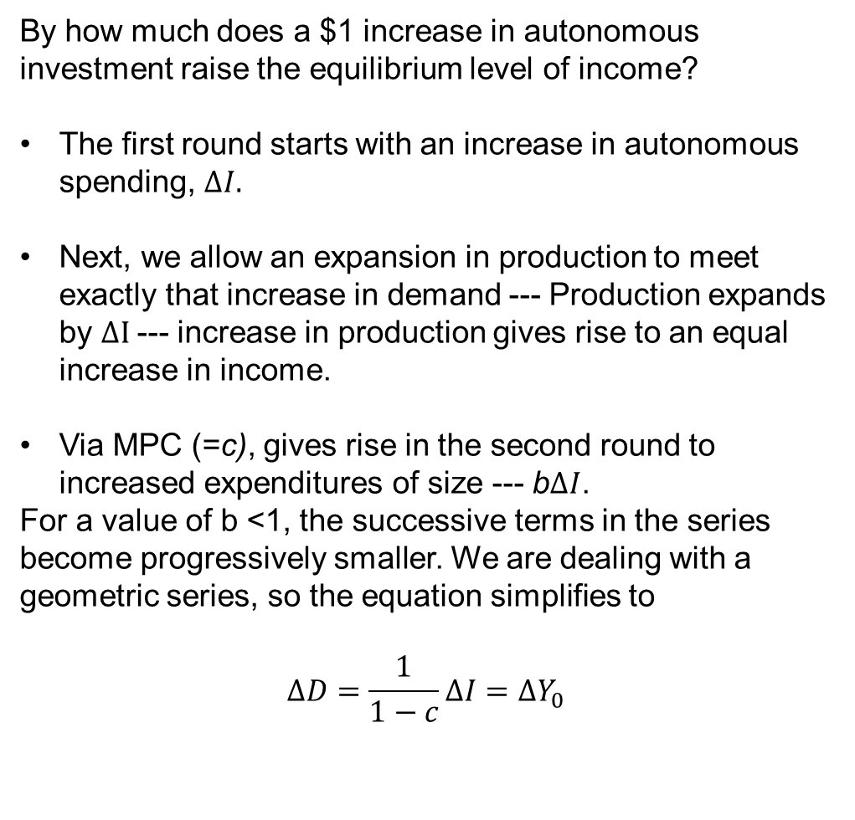
Operation of Multiplier
By how much does a $1 increase in autonomous investment raise the equilibrium level of income?
The first round starts with an increase in autonomous spending, $∆I.$
Next, we allow an expansion in production to meet exactly that increase in demand --- Production expands by $∆I$--- increase in production gives rise to an equal increase in income.
Via MPC (=c), gives rise in the second round to increased expenditures of size --- b$∆I$.
For a value of b <1, the successive terms in the series become progressively smaller. We are dealing with a geometric series, so the equation simplifies to
$$∆D=\frac{1}{1−c}∆I=∆Y_{0}$$
Round | Increase in Demand | $$∆Y$$ | $$\sum{∆Y}$$
1 | $$∆I$$ | $∆I$ | $∆I$
2 | $b∆I$ | $b∆I$ | $∆I+b∆I = (1+b)$ $∆I$
3 | $b^{2}∆I$ | $b^{2}∆I$ | $(1+b+b^{2})$ $∆I$
4 | $b^{3}∆I$ | $b^{3}∆I$ | $(1+b+b^{2}+b^{3})$ $∆I$
…. | ….. | .... | …..
t | $$b^{t−1}∆I$$ | $$b^{t−1}∆I$$ | $$\frac{1}{1−b}∆I$$

Slide 5
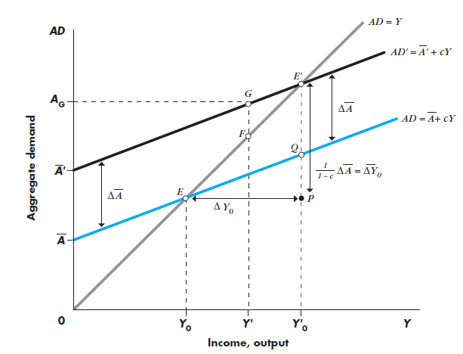
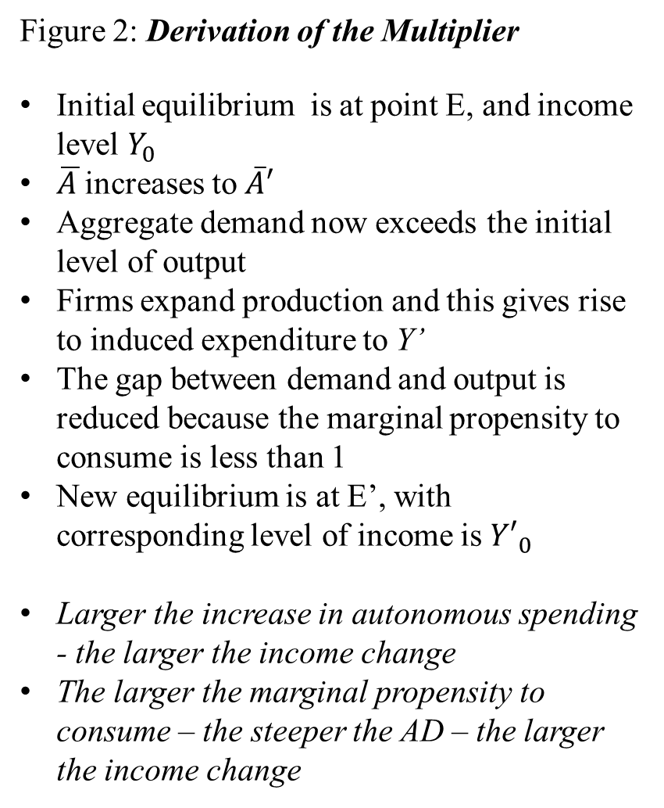
Figure 2: Derivation of the Multiplier
Initial equilibrium is at point E, and income level $Y_{0}$
$\overline{A }$increases to $\overline{A}′$
Aggregate demand now exceeds the initial level of output
Firms expand production and this gives rise to induced expenditure to Y’
The gap between demand and output is reduced because the marginal propensity to consume is less than 1
New equilibrium is at E’, with corresponding level of income is ${Y′}_{0}$
Larger the increase in autonomous spending - the larger the income change
The larger the marginal propensity to consume – the steeper the AD – the larger the income change

Slide 6
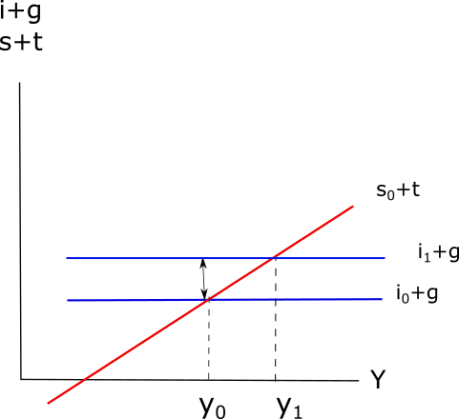
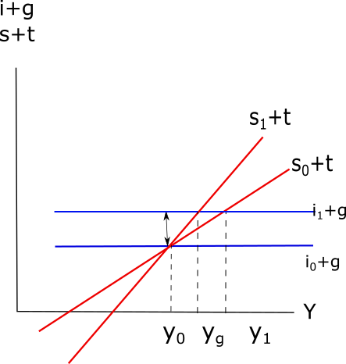


Change in Autonomous Investment and Change in Equilibrium Income
Increase in The Investment
$∆inv$
$∆inv$

Slide 7
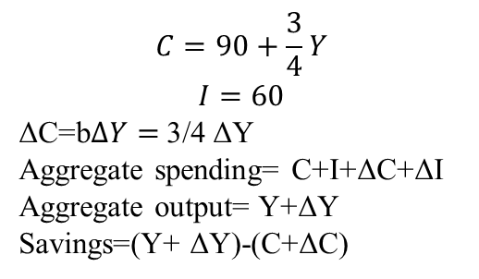
If the change in investment is temporary?
$$C=90+\frac{3}{4}Y$$
$$I=60$$
ΔC=b$∆Y=$3/4 ΔY
Aggregate spending= C+I+ΔC+ΔI
Aggregate output= Y+ΔY
Savings=(Y+ ΔY)-(C+ΔC)
Equilibrium at 600

Slide 8
If the change in investment is permanent?
New higher equilibrium level of output/ income at 720

Slide 9
References
William H Branson, Macroeconomic Theory and Policy, Second Edition, Universal Book Stall, New Delhi
E Shapiro, Macroeconomic Analysis, 5th Edition, Galgotia Publication Pvt Ltd., New Delhi.

